Slide 1
C# Professional Level 1
.Net framework & runtimes

Slide 2
Chapter Agenda
C# History
What is a .Net framework ?
What is a .Net runtime ?
What is .Net standard ?
What is .Net core?
How to choose the right runtime/framework ?

Slide 3
C# is a multi-paradigm language
Strongly typed
Imperative
Declarative
Functional
Generic
Object oriented
Component oriented
Created for .net by Anders Hejlsberg (Turbo Pascal, Delphi, Typescript)
Notes:
Strongly Typed: means that you must declare a specific “Type” for all the variable that you use, and you can’t assign “a text type” to “a number type”.
Imperative Programming: You need to write code that will explain exactly what you want to-do step by step.
Declarative Programming: You can write code that will tell what you want in return (for example LINQ) but not necessarily how to get it.
Functional Programming: come from the Mathematical logic, means that you can write function which concentrates on computing results rather than performing actions.
Generic Programming: allow you to create “class” or “method” that accept dynamic type parameter.
Allowing you for example to create one class that will work with different number types “MyClass<int>” and “MyClass<decimal>”. More about this Generic classes and methods
Object oriented Programming: object-oriented programming focuses on the relationships between classes that are combined into one large binary executable. In the traditional object-oriented world, even though you may factor the business logic into many fine-grained classes, once those classes are compiled, the result is monolithic binary code. All the classes share the same physical deployment unit (typically an EXE), process, address space, security privileges, and so on. If multiple developers work on the same code base, they have to share source files. In such an application, a change made to one class can trigger a massive re-linking of the entire application and necessitate retesting and redeployment of all the other classes.
Component oriented Programming: component-oriented programming focuses on interchangeable code modules that work independently and don’t require you to be familiar with their inner workings to use them. You can treat them like “LEGO” bricks that will be “glued” together by your application. It differs from a Monolithic Applications that will contains all the logic and require a full rebuild if a change is made to one class (which results in a full re-test & redeployment). Component-oriented programming promotes black-box reuse, which allows you to use an existing component without caring about its internals, as long as the component complies with some predefined set of operations or interfaces.

Slide 4
A brief history of C# (1/2)​
C#2.0
C#4.0
C#6.0
2005
2010
2015
C#1.0
Generics
Partial types
Anonymous methods
Nullable value types
Iterators
Covariance and contravariance
Dynamic binding (dynamic keyword.)
Named/optional arguments
Generic covariant and contravariant
Embedded interop types
Exception filters
Auto-property initializers
Expression bodied members
Null propagator
String interpolation
nameof operator
Index initializers
Await in catch/finally blocks
Roslyn the compiler as a service.
2002
.NET Framework 1.0 Visual Studio .NET 2002
C#1.2
C#3.0
C#5.0
2003
2007
2012
.NET Framework 1.1 Visual Studio .NET 2003
Auto-implemented properties
Anonymous types
Query expressions (LINQ)
Lambda expressions
Extension methods
Implicitly typed local variables (var)
Partial methods
Object and collection initializers
Asynchronous members (async/await)
Caller info attributes

Slide 5
A brief history of C# (2/2)​
C#7.0
C#9.0
C#10.0
2017
2020
Out variables
Tuples and deconstruction
Pattern matching
Local functions
Expanded expression bodied members
Ref locals and returns
Discards
Binary Literals and Digit Separators
Throw expressions
2021
Records
Init only setters
Top-level statements
Pattern matching enhancements
Target-typed new expressions
static anonymous functions
Lambda discard parameters
Record structs
Improvements of structure types
Interpolated string handlers
global using directives
File-scoped namespace declaration
Allow const interpolated strings
Allow AsyncMethodBuilder attribute on methods
CallerArgumentExpression attribute
to continue…
C#8.0
C#11
2019
2022
Readonly members
Default interface methods
Pattern matching enhancements
Using declarations
Static local functions
Disposable ref structs
Nullable reference types
Asynchronous streams
Indices and ranges
Null-coalescing assignment
Raw string literals
Generic math support
Generic attributes
Newlines in string interpolation expressions
List patterns
File-local types
Required members
Notes:
More to learn on : https://learn.microsoft.com/en-us/dotnet/csharp/whats-new/csharp-version-history

Slide 6
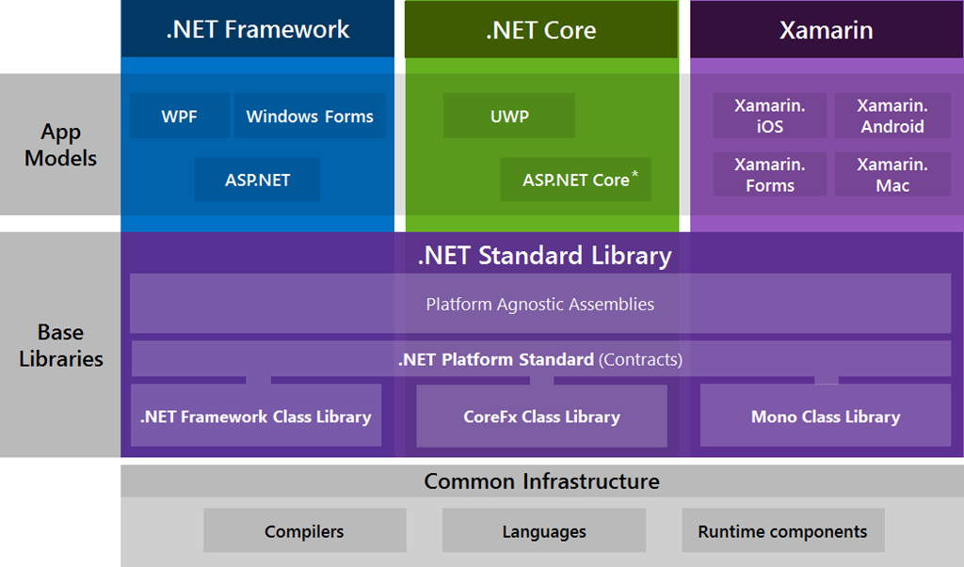
From multiple frameworks …
Notes:
Over the years, .NET aim to target multiple platforms :
.NET Framework
Desktop or Web Application
.Net Core
Desktop
Win 10+ UWP (Universal Windows Platform)
Web
Cloud (Azure)
IoT (Win10 IoT Core)
Xamarin
iOS
Android

Slide 7
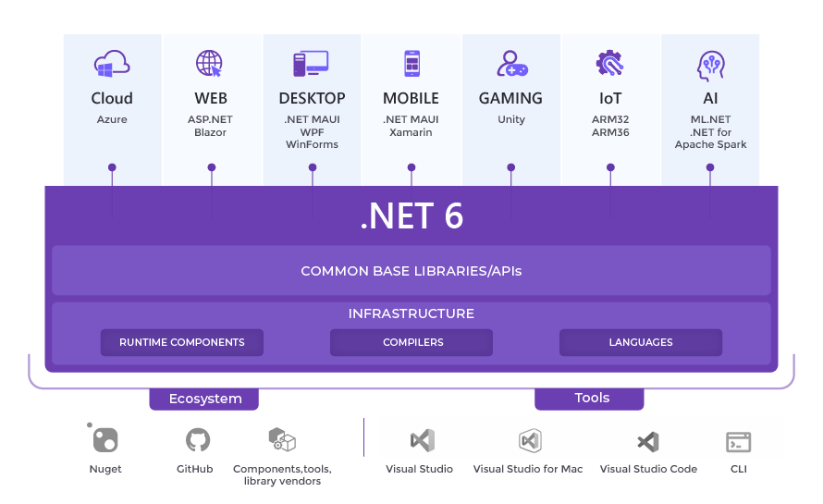
… towards a unified framework
Notes:
.NET 6 delivers the final parts of the .NET unification plan that started with .NET 5 .
NET 6 unifies the SDK, base libraries, and runtime across mobile, desktop, IoT, and cloud apps.

Slide 8
.Net Framework
Historical framework
Not linked to a specific C# language version
Targets:
Windows
Azure
Application types:
Web
Desktop
Server
Notes:
If your application targets fx4.5, the app will run on fx4.6.1 if the 4.6.1 is installed
Consider the version in the assembly as the minimum version not the target version.

Slide 9
.Net Core
Last framework created
Cross platform (X Plat)
Windows
Linux
MacOs
Azure (Pass)
Docker
Lightweight
100 % Side by side
Best choice for
Microservices
Containers
High performance and scalable systems needs
Visual Studio: 2017 and above
Notes:
https://docs.microsoft.com/en-us/dotnet/articles/standard/choosing-core-framework-server
Side-by-side execution is the ability to run multiple versions of an application or component on the same computer. You can have multiple versions of the common language runtime, and multiple versions of applications and components that use a version of the runtime, on the same computer at the same time.

Slide 10
.Net Standard
Set of common specifications
Versioning: backward compatibility
Replacement of Portable Class Libraries (PCL)
Feature introduced to help build cross-platform applications and libraries
Cross platform
Notes:
You can see the .NET Standard API definition in the dotnet/standard repo on GitHub.
.NET Standard will replace Portable Class Libraries (PCLs) as the tooling story for building multi-platform .NET libraries.
PCL let developers create dedicated component that can be reused in different targeted frameworks (i.e. : common library across .NET Framework / Xamarin)
N.B : strongly discourage to be used by Microsoft as of today

Slide 11
.Net unified
New implementation of .Net after .NET Core 3.1 & .NET Framework 4.x
.NET 6 released in November 2021
Support for C# 10 and F# 6
Great performance enhancements across many components
Start of « unification journey » by .NET development teams.
Provide a single framework for all .NET developers
Support development of mobile, web, desktop, cloud
Notes:
.NET 7 released on November 2022 including .NET MAUI (STS) before the next major release, .NET 8 which is plan to be released on November 2023 as a LTS version.
STS – Short Term Support: 18 months of support
LTS – Long Term Support : 3 years

Slide 12
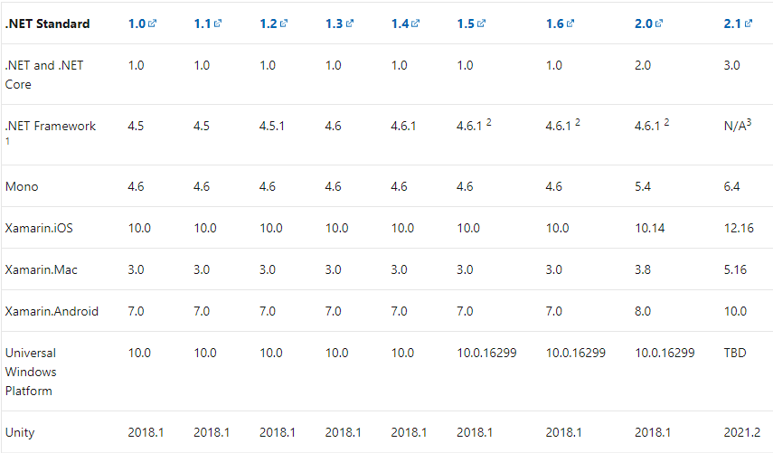
.Net Standard versions
I need to target net 4.6 and netcoreapp 1.0 ?
Notes:
.NET Standard 1.0 was in some way a “baseline” and around 8000 APIs common across all Frameworks.
After each releases, new APIs were added to .NET Standard but required specific release of Frameworks to work with.
i.e. : .NET Standard 1.3 is only implemented starting .NET Framework 4.6 / .NET Standard 2.1 is no longer supported by .NET Framework => https://dotnet.microsoft.com/en-us/platform/dotnet-standard
.NET Standard 2.0 will be implemented by .NET Framework, .NET Core, and Xamarin. For .NET Core, this will add many of the existing APIs that have been requested (~33000 APIs)
.NET Standard 2.0 includes a compatibility shim for .NET Framework binaries, significantly increasing the set of libraries that you can reference from your .NET Standard libraries.

Slide 13
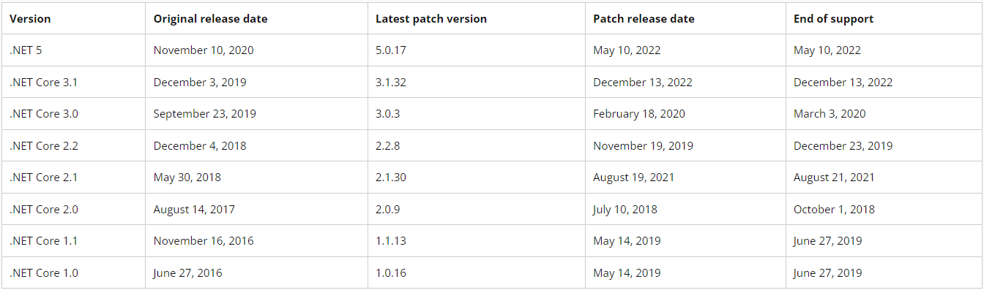
end-of-life table for Frameworks
Supported versions
Out of support versions

Slide 14
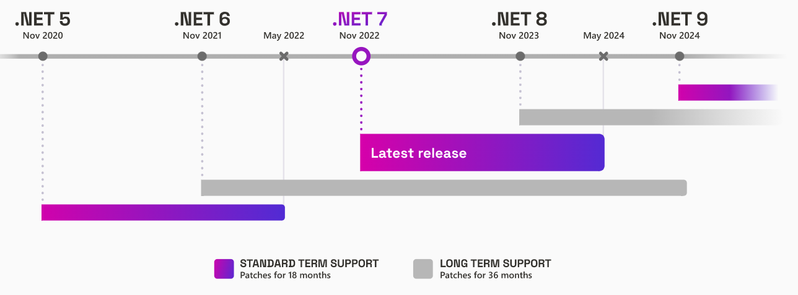
.NET release cycle
Notes:
Releases alternate between LTS and STS, so it's possible for an earlier release to be supported longer than a later release. For example, .NET Core 3.1 is an LTS release with support through December 2022. The .NET 5 release shipped almost a year later but went out of support earlier, in May 2022.
How to choose a release
If you're building a service and expect to continue updating it on a regular basis, then an STS release like .NET 7 may be your best option to stay up to date with the latest features .NET has to offer.
If you're building a client application that will be distributed to consumers, stability may be more important than access to the latest features. Your application might need to be supported for a certain period before the consumer can upgrade to the next version of the application. In that case, an LTS release like .NET 6 might be the right option.

Slide 15
When / Why do I care about .Net Standard
You don’t know where your code will run (i.e. which runtime)
You don’t want to be dependent to a platform
You are writing a framework component

Slide 16
Managed code
Code managed by a runtime
The .Net Framework runtime is called CLR
JIT (Just In Time) Compilation (Chapter 2)
Memory Management
Garbage Collector (Chapter 3)
Security and Thread Management
CLR <> CoreCLR
High level, à re linker aux bons chapitres
Notes:
Managed code is computer program code that requires and will execute only under the management of a Common Language Runtime virtual machine, typically the .NET Framework, or Mono. The term was coined by Microsoft.

Slide 17
Where do you code & develop ?
In order to realize projects in C# several IDE are available.
The two most used are :
Microsoft Visual Studio
Commonly called visual studio
It allows to make all the development of the various Microsoft bricks either natively or by the use of Plug in
Visual Studio Code
commonly called VS Code
It allows you to do all types of development and works with the help of plug-ins. A Plug In allows the support of a type of development.

Slide 18

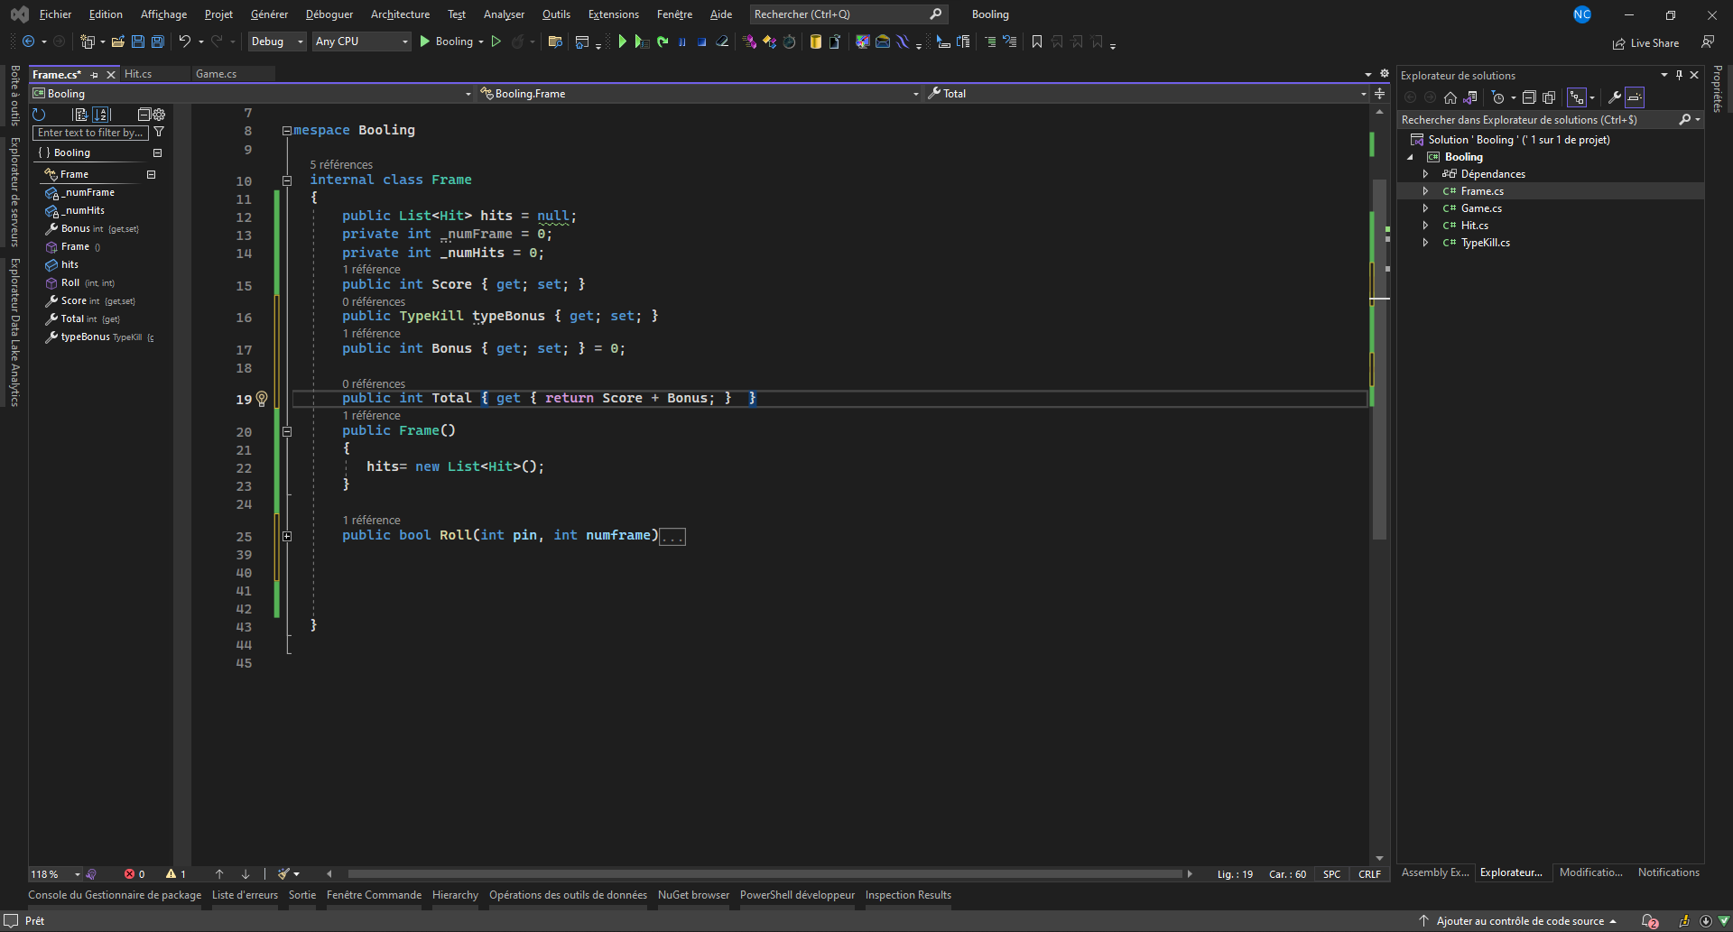
Visual Studio

Slide 19

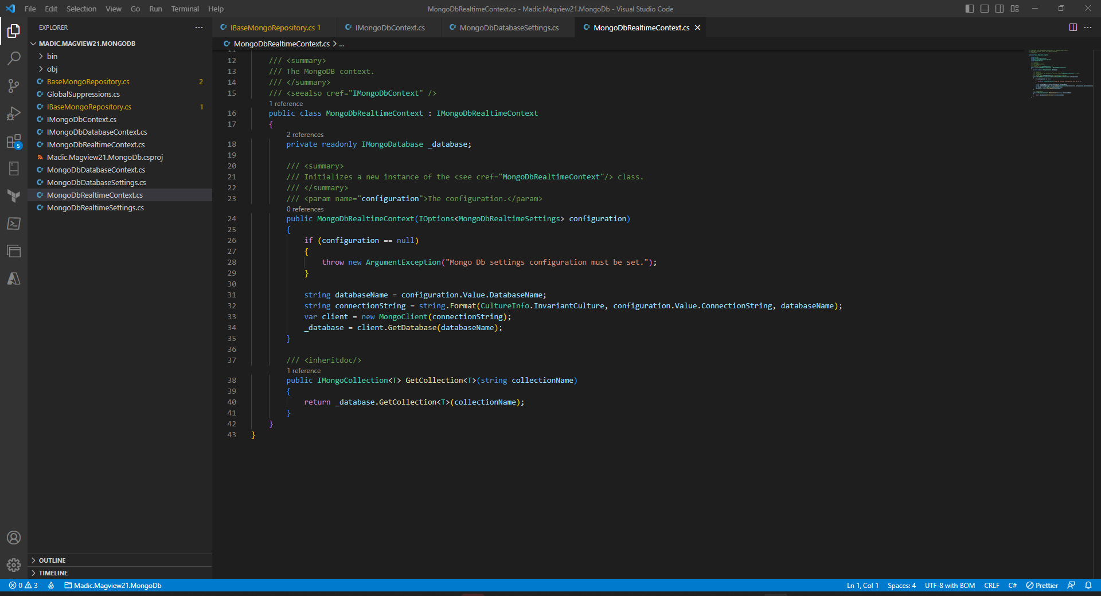
VS Code

Slide 20
Guidelines
DO | Prefer targeting .NET 6 for new projects
DO | Specify the .NET framework version in your project specifications
DON’T | Use PCL, use .NET Standard libraries
DON’T | Choose a .NET Framework version without knowning the target platform (production )
DON’T | Change your .NET Framework version without impact analysis

